Slide 1
Scientific and Religious Belief
ID1003 Dr John Mitchell jbom@st-andrews.ac.uk

Slide 2
1. A Caricature of Conflict

Slide 3
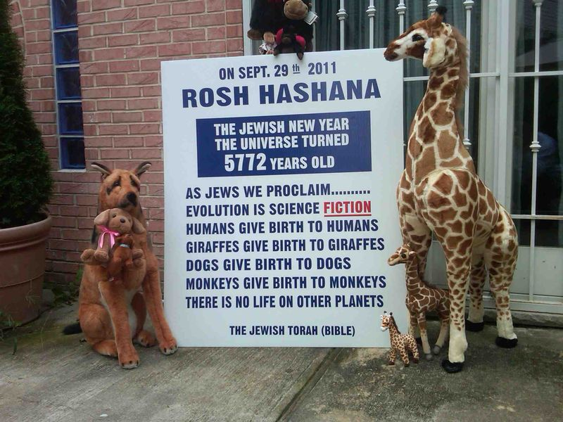

Slide 4
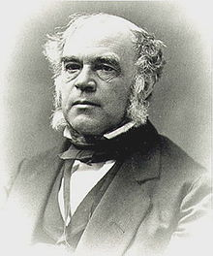
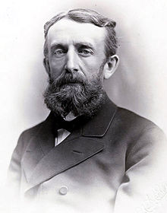
Are religious and scientific ideas in essential conflict?
The “conflict thesis” holds that there is a fundamental incompatibility between religious and scientific ways of viewing the world.
Such a view is often reinforced by very public expressions of intellectual hostility between religious and atheist campaigners, and is sometimes taken to a personal or emotive level.
John William Draper: History of the Conflict between Religion and Science (1874)
Andrew Dickson White: A History of the Warfare of Science with Theology in Christendom (1896)

Slide 5
Are religious and scientific ideas in fundamental conflict?
Typically the conflict is seen as being between “scientific atheism” and the “fundamentalist” beliefs held by some adherents of many spiritual traditions, but most notably by extremist elements of Judaism, Christianity and Islam.
Whilst fundamentalism is not the entire story of the science-religion dialogue, it is what we will look at first.

Slide 6
Aspects of fundamentalist belief
This kind of religious belief is often characterised both by a doctrine of an inspired and error-free scripture and also by a lack of willingness to explore its interpretation as literature or the limitations of its original historical and societal context.
In Christian fundamentalism, this is a combination of both a doctrine of biblical inerrancy (“the Bible is not just inspired by God, but also is free from any error”) and a literalist approach to understanding what the Bible means. Importantly, this extends not just to moral teaching but also to matters of historical and scientific “fact”.

Slide 7
Consequences of a fundamentalist approach to belief
Famously (or infamously), such an approach has led some Christians to believe that the creation and fall accounts of chapters 1 to 3 of Genesis must be literally true in every detail, producing some counter-scientific beliefs …

Slide 8
Creationist view of sin and “the fall”

Slide 9
Creationist view of sin and “the fall”
God blamed Adam
Adam blamed Eve
Eve blamed the serpent
The serpent didn’t have a
leg to stand on.

Slide 10
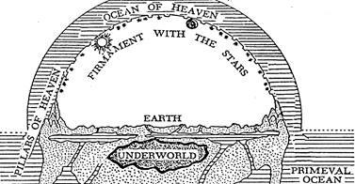
Consequences of a fundamentalist approach to belief
“The Earth is young.” Extremely literal attempts at dating ‘creation’ based on biblical genealogies gave dates around 4000 BC (Archbishop Ussher in the 17th century famously dated creation to Sunday 23 October 4004 BC).
“Species do not change.”
“There is no pre-human natural history” (beyond a few days).
“The first man was formed directly by God from dust and the first woman from his rib.”
“The imperfection of human nature (sin) and of the natural order arose as a result of a particular man’s (& woman’s) choice to disobey God.”
“Death only entered the world as a consequence of sin.”
Representation of Hebrew cosmology

Slide 11
If one holds these beliefs, then ones rejects science
“The Earth is young.” Extremely literal attempts at dating ‘creation’ based on biblical genealogies gave dates around 4000 BC (Archbishop Ussher in the 17th century famously dated creation to Sunday 23 October 4004 BC).
“Species do not change.”
“There is no pre-human natural history” (beyond a few days).
“The first man was formed directly by God from dust and the first woman from his rib.”
“The imperfection of human nature (sin) and of the natural order arose as a result of a particular man’s (& woman’s) choice to disobey God.”
“Death only entered the world as a consequence of sin.”
Representation of Hebrew cosmology

Slide 12
Repudiating such fundamentalism is not a criticism of religious faith in general.
“The Earth is young.” Extremely literal attempts at dating ‘creation’ based on biblical genealogies gave dates around 4000 BC (Archbishop Ussher in the 17th century famously dated creation to Sunday 23 October 4004 BC).
“Species do not change.”
“There is no pre-human natural history” (beyond a few days).
“The first man was formed directly by God from dust and the first woman from his rib.”
“The imperfection of human nature (sin) and of the natural order arose as a result of a particular man’s (& woman’s) choice to disobey God.”
“Death only entered the world as a consequence of sin.”
Representation of Hebrew cosmology

Slide 13
Some reasons why Christian fundamentalist beliefs persist
Fear that any retreat from biblical inerrancy and literal interpretation would cause belief system to collapse.
Centrality of “the fall” to their theology and the perceived difficulty of squaring this with mainstream views of anthropology and evolution.
“If you believe in one miracle (Jesus’ resurrection), why not believe in lots and lots of them?”
Lack of engagement of many Church leaders with mainstream academic study (including theology as well as science).

Slide 14
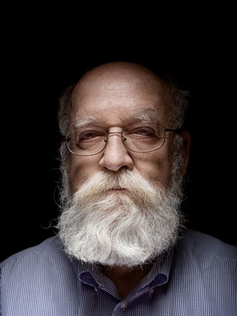
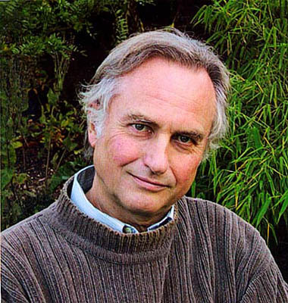
The “New Atheism”
Daniel Dennett
Christopher Hitchens (d. 2011)
Richard Dawkins
Just as fundamentalism is an extreme version of religious belief, the “new atheism” characterised by these thinkers is an extreme and radical form of non-belief (or maybe it’s just the old atheism repackaged in a less tolerant and respectful way).

Slide 15
The “New Atheism”
Although atheism, belief in the non-existence of any deity, has been present throughout history, the “new atheism” has specific characteristics …
Intolerance of religious belief. Unlike the many atheists who accept both the importance of faith for other people and its tenability, the more extreme amongst new atheists argue that faith is nonsensical and that religion is a malign influence that should be opposed.
Appeal to scientific evidence to justify belief in the non-existence of any deity.
Sometimes, but not always, goes as far as to claim that science doesn’t just allow the non-existence of God (i.e., essentially neutral regarding religious belief), but requires no deity to exist (i.e., essentially atheistic), taking to extremes the arguments made in Dawkins’ The Blind Watchmaker.
Requires that the existence of God is a scientific hypothesis (that can be refuted from observational evidence – discussed in next lecture).
Sometimes considered to be atheistic fundamentalism.

Slide 16
The New Atheism’s Invisible Pink Unicorn
The invisible pink unicorn is an intellectual device intended to ridicule religious belief, the implication being that belief in God is logically equivalent to belief in an [implied to be patently ridiculous] invisible pink unicorn.

Slide 17
What Don’t Do Atheists Believe?
Atheists are typically defined by what they don’t believe.
That doesn’t imply that all atheists believe exactly the same things: “The only common thread that ties all atheists together is a lack of belief in gods ... atheists do not have a common belief system” (American Atheists web site).
It would be interesting to discover the range of atheist views on questions like “Why is there a Universe at all”, or more modern hypothetical questions like “Are we part of a multiverse”, and “Is our universe an aliens’ scientific experiment”, or even “Is our world a computer simulation?”
Some of these are discussed in the next lecture.

Slide 18
Tweedle-creationist and Tweedle-atheist have their battle
The creationist fundamentalists and the new atheists make attractive opponents for one another.
For the new atheists, the most extreme creationists make suitable “straw men”, whose arguments can be easily refuted by reference to science. Having defeated them, the atheists may claim to have “disproved religion”.
For the religious fundamentalists, tackling the most extreme atheists as opponents allows them to present the debate in a black-and-white and conflict-centric way as Good v. Evil, God v. Satan or Gospel Truth v. Secular Falsehood, without having to consider any middle ground.

Slide 19
But is their war just a sideshow?
It is entirely obvious that religious and atheist fundamentalists will disagree with one another.
But perhaps creationist fundamentalists are not representative of reasonable, educated believers of any religion?
And perhaps the new atheists’ claim that science disproves the existence of a deity is not representative of most scientists’ understanding of science?

Slide 20
Simple Summary
Religious
Fundamentalism
New Atheism
Intellectual Territory
Moderate
Religion
Science

Slide 21
Simple Summary
Religious
Fundamentalism
Conflict
New Atheism
Conflict
Conflict
Moderate
Religion
No conflict
Science

Slide 22
But is their war just a sideshow?
It is entirely obvious that religious and atheist fundamentalists will disagree with one another.
But perhaps creationist fundamentalists are not representative of reasonable, educated believers of any religion?
And perhaps the new atheists’ claim that science disproves the existence of a deity is not representative of most scientists’ understanding of science?
Does history suggest that there is still a possibility of a meaningful dialogue between science and religion?

Slide 23
2. The Rise of Science

Slide 24
A very brief history of science
There was some recognisable science in ancient Greece, both in mathematics and also for instance in Erastosthenes’ feat of calculating the circumference of the (round!) Earth in about 240BC.
Science developed substantially in Europe from about the 15th century onwards. Most scientists at this time were religious believers who saw no conflict between their theology and their science. Scientists such as Isaac Newton (1642-1727) and Robert Boyle (1627-1691) saw their scientific work as an exploration of how God reveals himself in nature.
In 1543, Nicolaus Copernicus published De revolutionibus orbium coelestium. In this book he championed the revolutionary idea that the Earth and planets orbit the sun (he actually knew that the idea went back at least to the Greek Aristarchus of Samos in ~270BC).
At this time, Christian and Jewish scholars generally viewed the Bible as endorsing a geocentric universe with a fixed Earth.

Slide 25
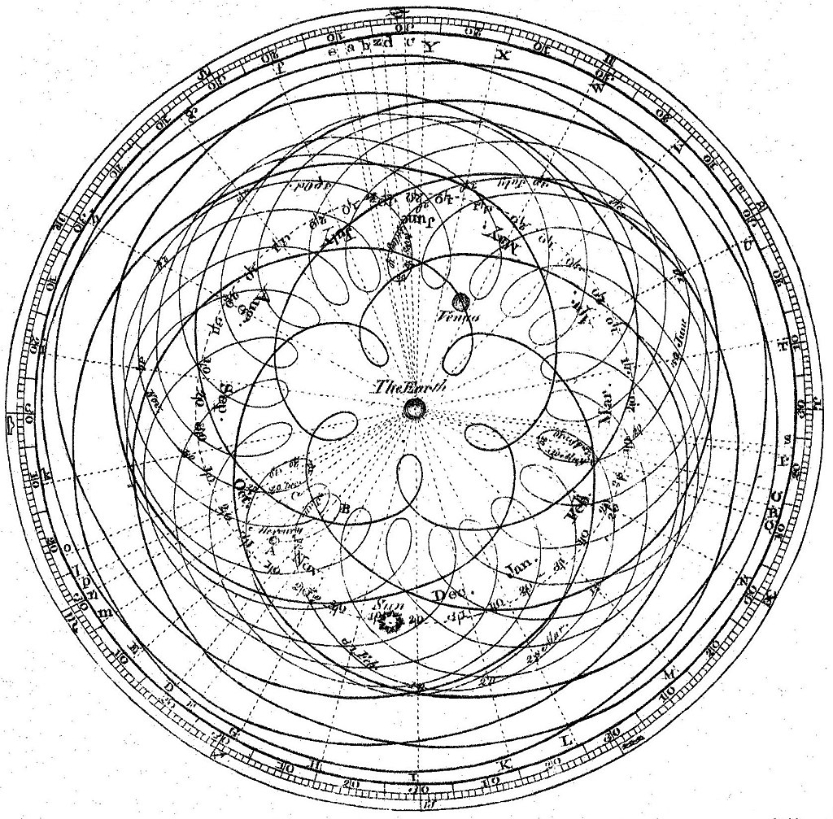
The Geocentric Model Required Complex Epicycles
Without epicycles, the match to astronomical observations was absurdly bad.

Slide 26
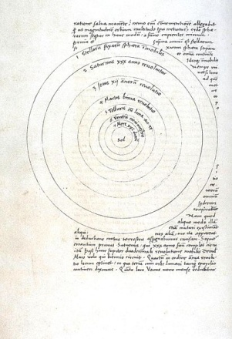
Heliocentrism
Copernicus’ theory gave a more elegant explanation for observed planetary motions and especially for apparent retrograde motion, but initially had no direct evidence that the Earth moved (only much later were parallax and aberration observed), nor any better predictions than geocentric models with epicycles.
However, once refined by Johannes Kepler (1571-1630) to include elliptical orbits, the heliocentric model did then make better and testable predictions, including transits of Venus and Mercury. Elliptical orbits arise naturally from Newtonian physics.
Galileo Galilei (1564-1642) observed the phases of Venus, demonstrating that it orbits the Sun not the Earth, and found four moons of Jupiter.

Slide 27
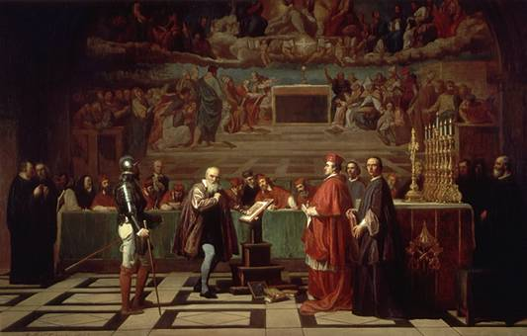
Galileo
With minimal diplomacy, Galileo offended the church authorities not so much by advocating heliocentrism, but more by attributing the Pope’s views to a ridiculous character Simplicio in his Dialogue Concerning the Two Chief World Systems. In 1633, Galileo was ordered to recant and placed under house arrest.

Slide 28
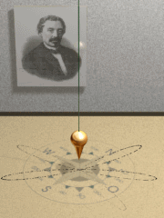
Religious responses to heliocentrism
Initially many major religious figures, including Protestants like Martin Luther and John Calvin, opposed heliocentrism. The Catholic hierarchy’s opposition was crystallised by Galileo affair. Judaism was also initially opposed. In each case, opposition was based on a literalist understanding of scripture.
Nonetheless, evidence mounted for the Earth orbiting the sun, Bradley observing aberration of starlight in 1727 and Bessel accurately measuring stellar parallax in 1838. Foucault’s pendulum (1851) demonstrated the Earth’s rotation on its axis.
Over time, the mainstream religious traditions acted reasonably in gradually accepting the findings of science in relation to the solar system.
The Catholic church’s official ban on publishing heliocentric ideas was dropped in stages between 1758 and 1822.

Slide 29
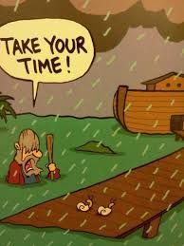
Geology
Before the birth of modern geology, it was common to believe that rock formations and fossils were remnants from Noah’s flood.
Evidence of past glaciation eventually caused early geologists like William Buckland (1784-1856) and Adam Sedgwick (1785-1873) to question the flood as a plausible explanation.

Slide 30
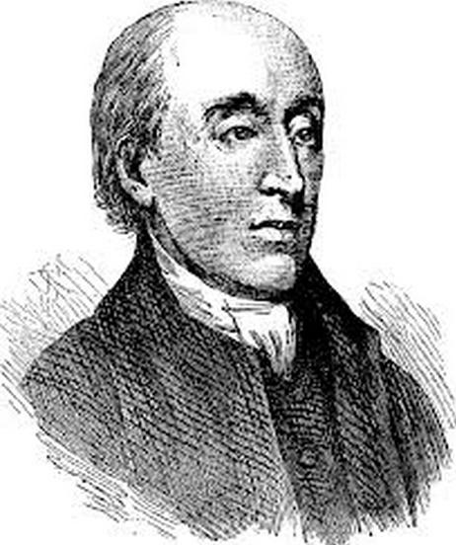
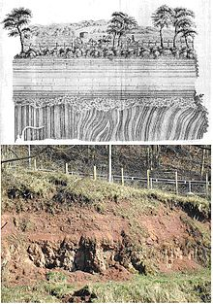
Geology: Hutton & Lyell
The contributions of two Scottish-born geologists were to cause a seismic shift in the understanding of the history of the Earth. James Hutton (1726-1797) and Charles Lyell (1797-1875) realised that the observed rock formations implied geological processes that must have taken extremely long periods of time.
James Hutton

Slide 31
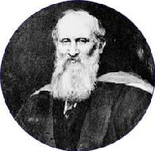
Geology and the age of the Earth
William Thomson, Lord Kelvin, a devout Christian, computed an age range for the Earth around 1864 based on the idea that it had gradually cooled from a ball of molten rock. This suggested that the Earth might be 20-400 million years old.
This was old enough to be clearly at variance with literalist biblical interpretations.
Actually, Kelvin’s calculation was a serious underestimate, because it over-simplified the structure of the Earth and also ignored heat generated by radioactivity. Early calculations of the sun’s age were similarly underestimated because it was not understood that the sun is powered by nuclear fusion.

Slide 32
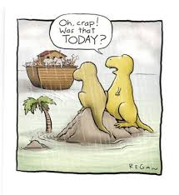
Implications for religious doctrine
The principal implications for religious doctrine were twofold …
The observed rock formations and fossils were not the result of a recent global flood.
The Earth was very much older than implied by a literal reading of the Bible.

Slide 33
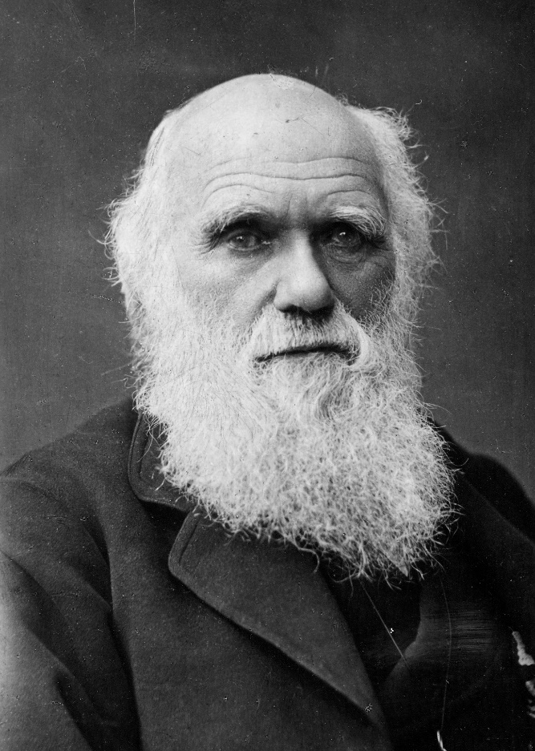
Darwin and evolution
Although Charles Darwin was not the only thinker pursuing evolutionary ideas in the 19th century, his On the Origin of Species (1859) was one of the most significant and influential books of all time.
While he had only a tiny fraction of the evidence for evolution that is now available, his carefully-argued book was to change the world.
Not only did Darwin do away with literal six-day creation, but he brought humankind closer to the animals. This opened up the question of what it means to be human.

Slide 34
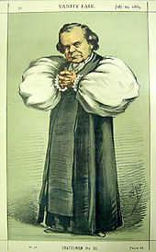
Reaction to evolution (1)
Evolution was a radical idea and was initially controversial amongst religious believers. The opposition of Bishop Samuel Wilberforce is well known, asking Thomas Huxley if he was descended from a monkey through his grandmother or grandfather’s side of the family. However, it is probably fairer to say that the Origin prompted debate rather than universal opposition.
Although there was also debate amongst Catholics, the Vatican remained officially silent on the issue.
There were also discussions in Jewish circles, but biblical literalism was already a minority position there.

Slide 35
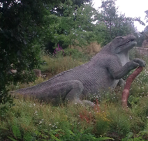
Reaction to evolution (2)
The mid-19th century also saw an upsurge of interest in newly discovered fossils of extinct creatures such as dinosaurs. This helped to embed the idea of an ancient pre-human natural history into public consciousness.
Models of Iguanadon, Ichthyosaurus and Plesiosaurus at Crystal Palace. Hugely popular in the mid-19th century, though now considered inaccurate.

Slide 36
Reaction to evolution (3)
The 20th century saw a general public acceptance of the reality of evolution through most of the developed world, though less so in the USA.
This reflects the influence of Christian fundamentalism in America.
Many Christian and Jewish leaders and believers have accepted evolution as scientific fact.
Acceptance of evolution by country in 2005 (National Geographic)

Slide 37
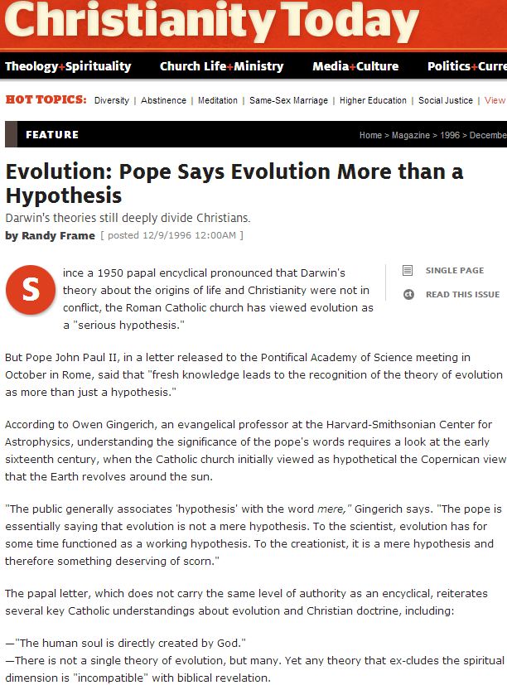
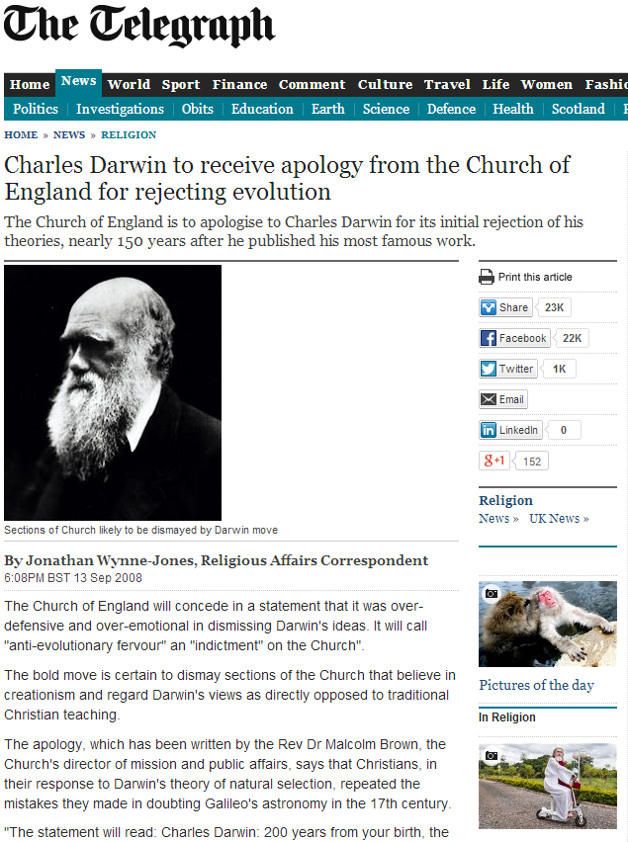
Mainstream voices in religious leadership tend now to be accommodating of science
[4] https://www.christianitytoday.com/ct/1996/december9/6te072.html
[5] http://www.telegraph.co.uk/news/religion/2910447/Charles-Darwin-to-receive-apology-from-the-Church-of-England-for-rejecting-evolution.html

Slide 38
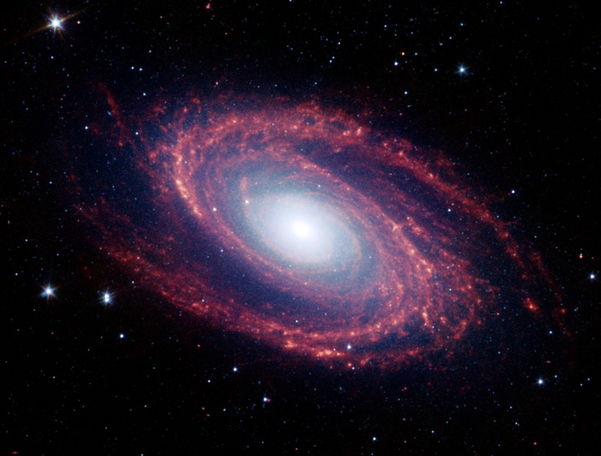
Modern science: astronomy
Distances of stars & galaxies combined with the speed of light mean that we see objects as they were long ago, (e.g., two million years ago for our neighbour, the Andromeda galaxy). This means that the universe is old.
Cosmology dates the Universe at approximately 13.8 billion years.
The constancy (or perhaps almost perfect constancy) of the speed of light can be confirmed by direct observation of the spectra of astronomical objects.
Applying our knowledge of physics to the sun suggests that it has been shining for about 4.6 billion years.
We see galaxies as they were many millions of years ago

Slide 39
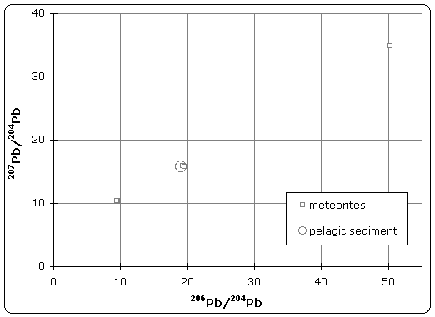
Modern science: geology
Dating of rocks by radiometric methods gives dates for their formation.
The oldest known surviving rocks are about 4 billion years old, but the Earth is likely to have been molten in its early history.
This leads to estimates around 4.54 billion years for the Earth’s age. An approximate upper limit is obtained from the ages of the oldest meteorites, dating the origin of the solar system.

Slide 40
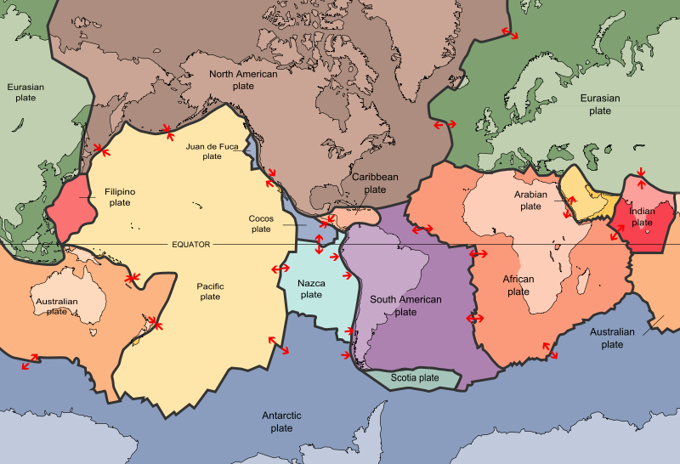
Modern science: paleomagnetism
Different strata of magnetic rocks have opposing directions of magnetization, and so must have been laid down when the Earth’s magnetic field had opposite orientations.
This implies that there have been numerous field reversals.
The most recent reversal occurred about three quarters of a million years ago.
Paleomagnetism was essential to the understanding of continental drift and the development of plate tectonics.

Slide 41
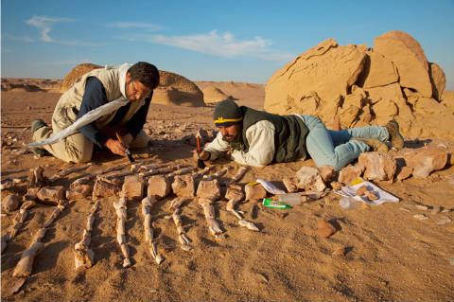
Modern science: paleontology
Fossils show that many of the animals and plants existing in the past were very different from those of today.
Dating of rocks allows dating of fossils.
Human remains are not found in ancient rocks. This shows that human history is only a small fraction of the fossil record.
We also see that individual locations have been at different times land and seabed – indeed, this was critical to Hutton and Lyell’s understanding that the Earth was ancient.

Slide 42
Modern science: bioinformatics (1)
We now have much genomic and other DNA & protein sequence data. This allows us to build up evolutionary family trees by finding the likely common ancestors. These trees are generally in agreement with trees derived purely from comparison of morphology.
One of the most useful methods of constructing trees is to utilise the rare insertion events that insert short and long interspersed elements into genomes, perhaps by a virus infecting a germ line cell and inserting its sequence into the host genome. Since it is very unlikely that an identical insertion will appear at exactly corresponding locations in distinct lineages, two species sharing a SINE or LINE must have diverged more recently than the insertion event.

Slide 43
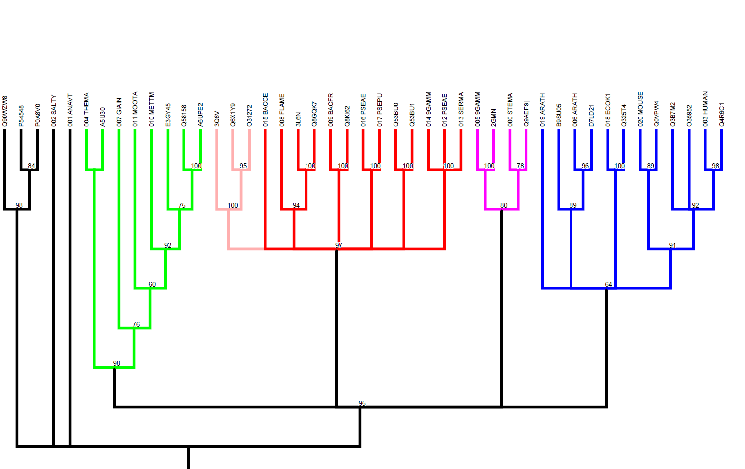
Modern science: bioinformatics (2)
We can trace molecular evolution through the sequences, structures and functions of homologous proteins in different organisms, identifying specific events such as gene fusion or duplication. We can also trace evolutionary changes in protein functions (e.g., eye lens crystallins are related to the enzyme aldose reductase).
We see non-expressed ‘fossil’ genes with enough information to be identifiable, but not enough to be functional, e.g., the human gene for the last stage of vitamin C synthesis.
Evolutionary family trees (phylogenetic trees) show how related proteins have evolved different functions

Slide 44
Scientific and Religious Belief: Summary so far
1a. Fundamentalist beliefs are anti-scientific and, if we take science at all seriously, counterfactual. But they do not represent the views of reasonable, educated believers.
1b. The “new atheism” is a less tolerant version of the old atheism, and could only have more explanatory power if the God hypothesis were scientifically testable.
2. Science has developed an impressive and predictive understanding of our world, an understanding that is independent of any particular religious or atheistic viewpoint.
ID1003 Dr John Mitchell jbom@st-andrews.ac.uk

Slide 45
Image Credits
http://diaryofanalevelstudent.wordpress.com/2012/10/30/science-vs-religion/
http://www.csicop.org/si/archive/category/volume_26.2
https://commons.wikimedia.org/wiki/File:John_William_Draper.jpg by Edward Bierstadt [Public domain]
https://en.wikipedia.org/wiki/Conflict_thesis#/media/File:Andrew_Dickson_White_1885.jpg
http://www.theatheistrabbi.com/tag/evolution-and-creationism
https://www.theguardian.com/science/political-science/2017/sep/05/questioning-evolution-is-neither-science-denial-nor-the-preserve-of-creationists
https://en.wikipedia.org/wiki/File:Ariane_Sherine_and_Richard_Dawkins_at_the_Atheist_Bus_Campaign_launch.jpg
http://www.richarddawkins.net/books/2013/8/6/the-god-virus-how-religion-infects-our-lives-and-culture
https://en.wikipedia.org/wiki/File:John_William_Draper.jpg
https://en.wikipedia.org/wiki/File:Andrew_Dickson_White_1885.jpg
http://www.catholicchapterhouse.com/blog/2011/07/14/science-in-the-bible/
http://cafewitteveen.wordpress.com/2011/02/15/then-on-the-eighth-day/
http://www.webpages.uidaho.edu/ngier/gre13.htm
http://biblische.blogspot.co.uk/2006/09/tree-of-knowledge-of-good-and-evil.html
http://freethinkernews.com/2013/06/on-daniel-dennetts-seven-tools-for-thinking/
http://latimesblogs.latimes.com/nationnow/2011/12/christopher-hitchens-death-reaction.html
http://nirmukta.com/2010/04/10/is-richard-dawkins-arrogant-ridicule-passion-and-the-new-atheists/
http://news.moviefone.com/2010/02/03/alice-in-wonderland-character-progression/
http://www.itsbeach.com/blog/2009/09/apollo-11-launch-sequence.html
http://www.npr.org/2011/11/08/141931239/for-copernicus-a-perfect-heaven-put-sun-at-center
https://en.wikipedia.org/wiki/File:Galileo_before_the_Holy_Office.jpg
https://en.wikipedia.org/wiki/File:Foucault_pendulum_animated.gif
http://www.irreligious.org/2013/10/funny-noahs-ark-cartoon-pictures.html#.Uw8gALfnTzY

Slide 46
https://en.wikipedia.org/wiki/File:Hutton_Unconformity,_Jedburgh.jpg
http://etc.usf.edu/clipart/60900/60973/60973_james_hutton.htm
http://www.connected-earth.com/Peopleandpioneers/Pioneers/K/Kelvin/index.htm
http://mpe2013.org/wp-content/uploads/2012/08/earth_SA5.jpg
http://wp.patheos.com.s3.amazonaws.com/blogs/unreasonablefaith/files/2012/07/noahs-ark-cartoon.jpg
https://commons.wikimedia.org/wiki/File:Charles_Darwin_photograph_by_Herbert_Rose_Barraud,_1881.jpg
https://en.wikipedia.org/wiki/File:WilberforceVanityFair.jpg
Crystal Palace dinosaur photos by John Mitchell
http://news.nationalgeographic.co.uk/news/bigphotos/21329204.html
http://www.christianitytoday.com/ct/1996/december9/6te072.html
http://www.telegraph.co.uk/news/religion/2910447/Charles-Darwin-to-receive-apology-from-the-Church-of-England-for-rejecting-evolution.html
http://www.wallcoo.net/nature/NASA_JPL_Stars_and_Galaxies/wallpapers/1280x800/Stars_Galaxies_pia04936.jpg
https://en.wikipedia.org/wiki/File:Paterson_isochron_animation.gif
https://en.wikipedia.org/wiki/File:Plates_tect2_en.svg
https://en.wikipedia.org/wiki/File:Geomagnetic_late_cenozoic.png
https://whyevolutionistrue.wordpress.com/2012/12/30/a-terrific-popular-article-on-the-evolution-of-whales/
Bioinformatics images: Rosanna Alderson, Daniel Barker & John Mitchell
American Atheists quote: https://www.atheists.org/activism/resources/about-atheism/

