Slide 1
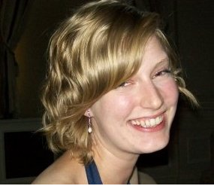
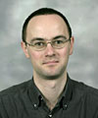
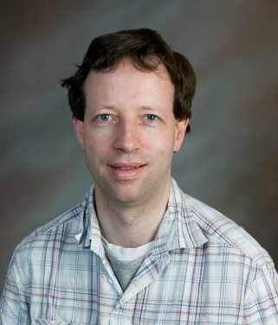
Recreating in silico the Natural History of Antibiotic Resistance
Rosanna Alderson
Daniel Barker
John Mitchell
Notes:
Beta lactmases antibiotics summarize

Slide 2
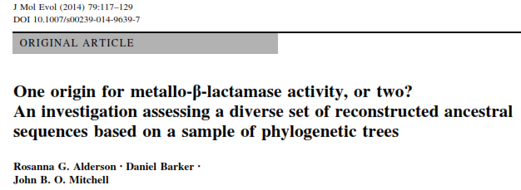
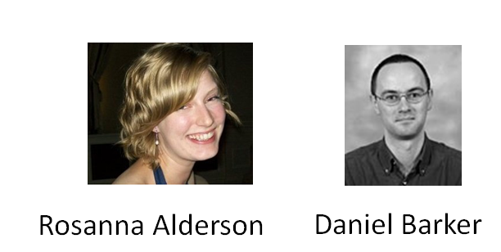
β-lactamase superfamily
β-lactam hydrolysis
Metallo-β-lactamase classification

Slide 3
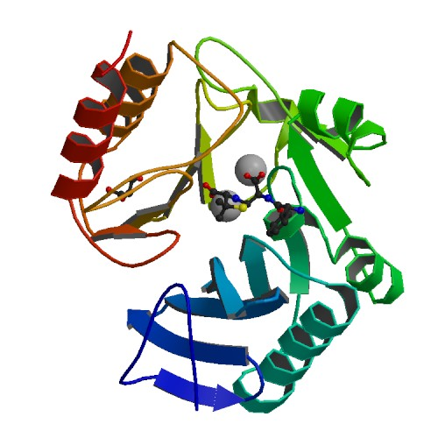
β-lactamase superfamily
β-lactam hydrolysis
Metallo-β-lactamase classification
CATH code- 3.60.15.10
Very diverse in range of substrate type.
Overall chemical mechanism- hydrolysis catalysed via a metal ion, commonly zinc, that activates a water molecule.
Includes the flavoproteins in which a beta-lactamase domain has joined onto a flavodoxin domain.
Notes:
Classification of domains aligning to flavoprotein.

Slide 4
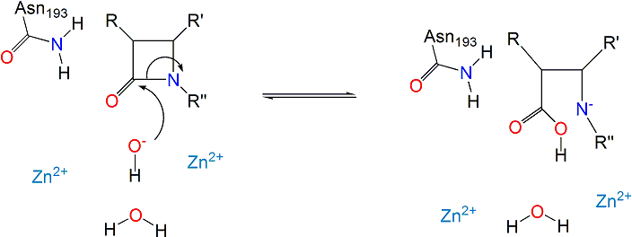
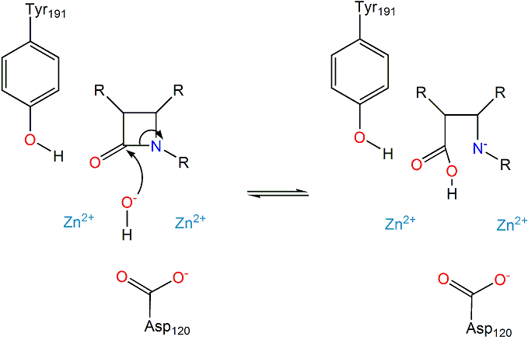
β-lactamase superfamily
β-lactam hydrolysis
Metallo-β-lactamase classification
M0015 1znb (B1)
M0258 1sml (B3)
Notes:
Stretched- check

Slide 5
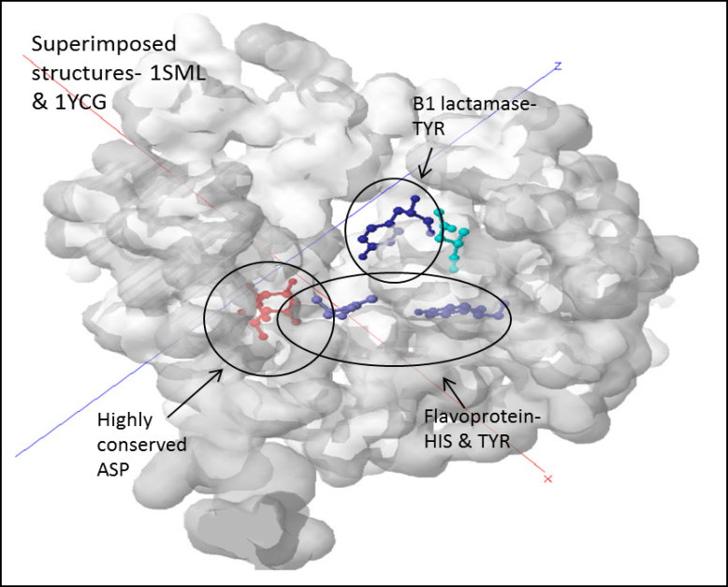
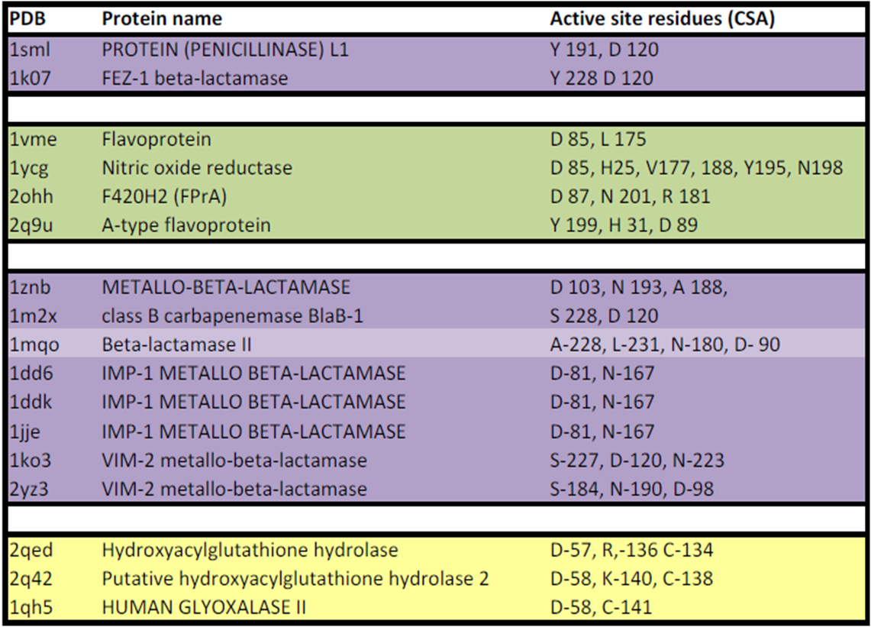
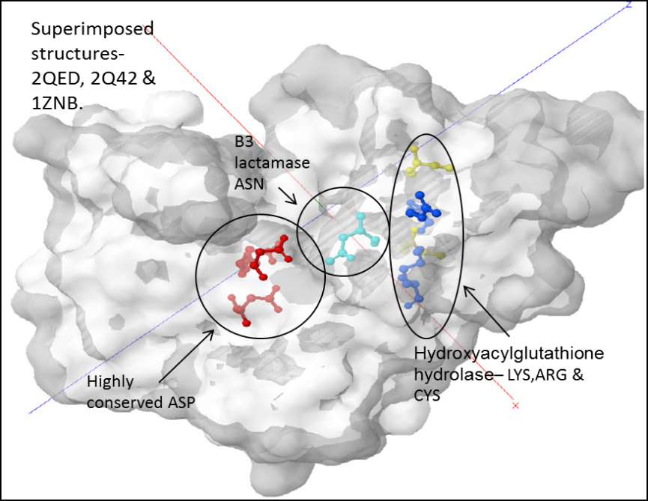
β-lactamase superfamily
β-lactam hydrolysis
Metallo-β-lactamase classification
B3
β- lactamases
B1

Slide 6
β-lactamase superfamily
β-lactam hydrolysis
Metallo-β-lactamase classification
Class A
Class B
Class C
Class D
subclass B1
subclass B1
The subclasses B1/B2 and B3 should be considered as distinct as the major classes of lactamase e.g. the serine lactamases to reflect their relative diversity in sequence and structure.
subclass B2
subclass B2
β- lactamases
subclass B3
subclass B3

Slide 7
What was the likely function of the common ancestor of the B1 & B3 subclasses? … Is it likely that lactam hydrolysis evolved independently more than once in this superfamily?

Slide 8
A simplistic analogy …

Slide 9
… what do these people have in common?

Slide 10
… what do these people have in common?
11th Doctor

Slide 11
… what do these people have in common?
11th Doctor
Singer

Slide 12
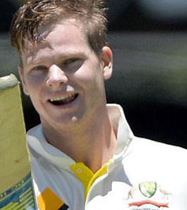
… what do these people have in common?
11th Doctor
Singer
Aussie cricketer

Slide 13
… what do these people have in common?
Matt SMITH
Sam SMITH
Steve SMITH

Slide 14
Going back a number of generations, individuals will share common ancestors …

Slide 15
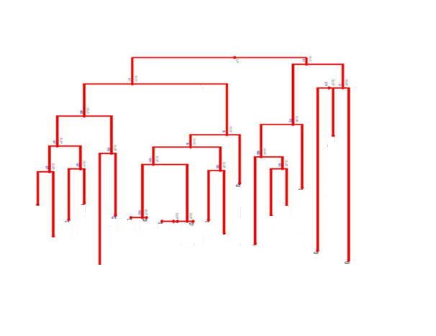
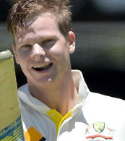

Slide 16
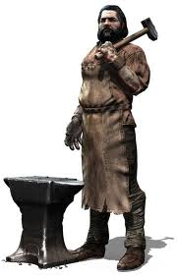

Slide 17
Was this common ancestor a Smith …

Slide 18
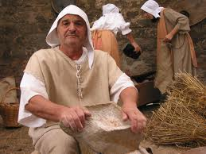
… or did the trait “Smith” originate independently more than once in the same lineage?

Slide 19
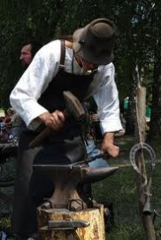
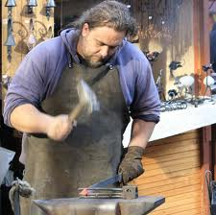
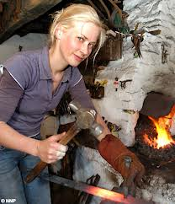

Slide 20
MRCA not a Smith
“Smith” arises independently multiple times

Slide 21
Building trees and the Most Recent Common Ancestor (MRCA) approach
Previous Work
Building trees
Unresolved consensus tree…
MRCA approach

Slide 22
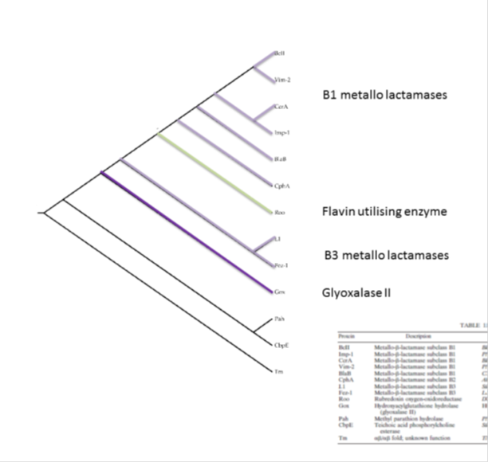
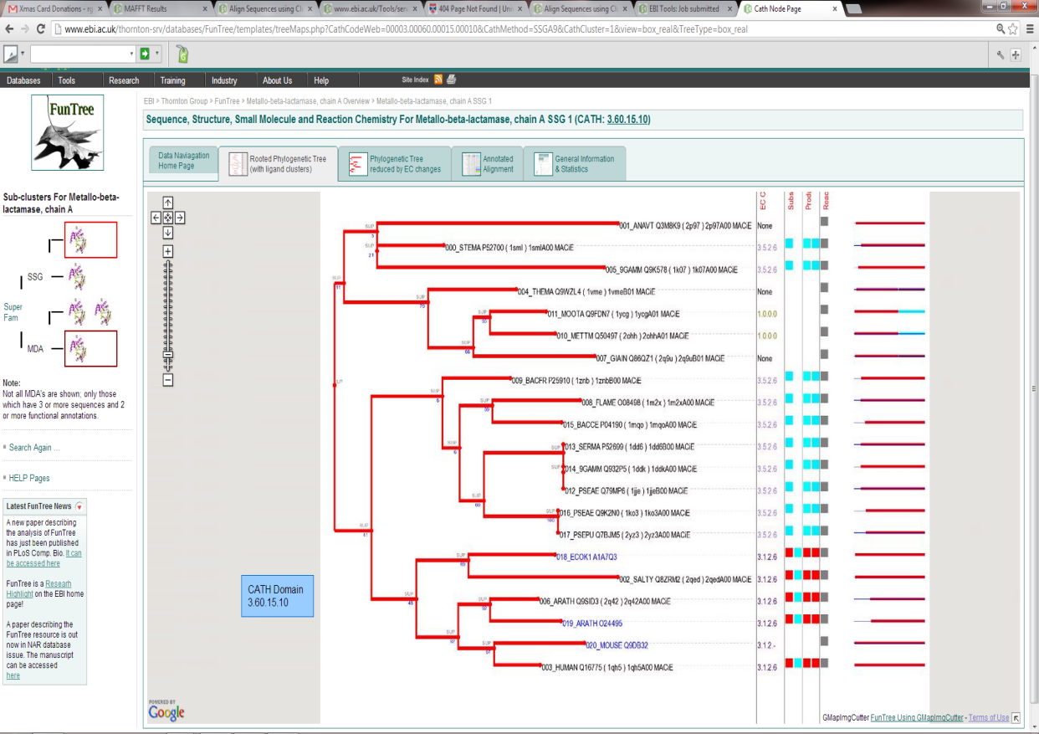
Previous Work
Building trees
Unresolved consensus tree…
MRCA approach
11
6
41
Notes:
Independent origins paper clear. Lack of homology
Time scales
Species tree guide- explain.

Slide 23
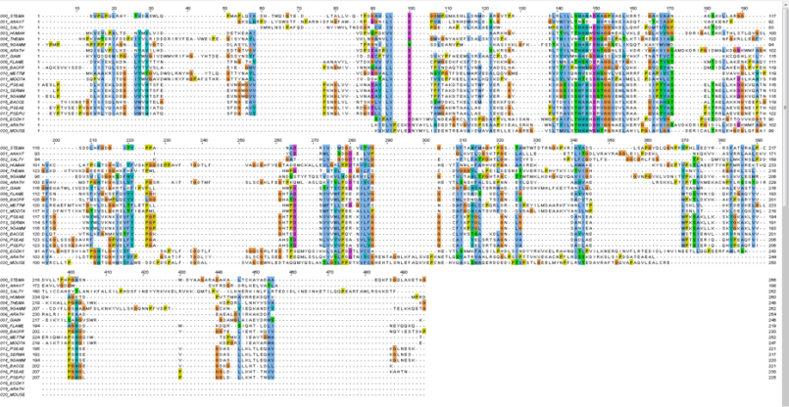
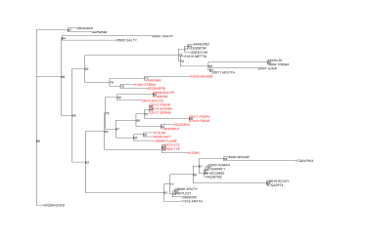
Previous Work
Building trees
Unresolved consensus tree…
MRCA approach
Orthologous sequences chosen, double no. of each functional class from UniProtKB
database
Profile aligned against ‘FunTree’
alignment low gap penalty
MAFFT- amino acid alignment
Maximum Likelihood trees built in PhyML
(100 bootstrap replicates WAG+G+I)
Estimate parameters for tree building from data
Notes:
Explain evolutionary models

Slide 24
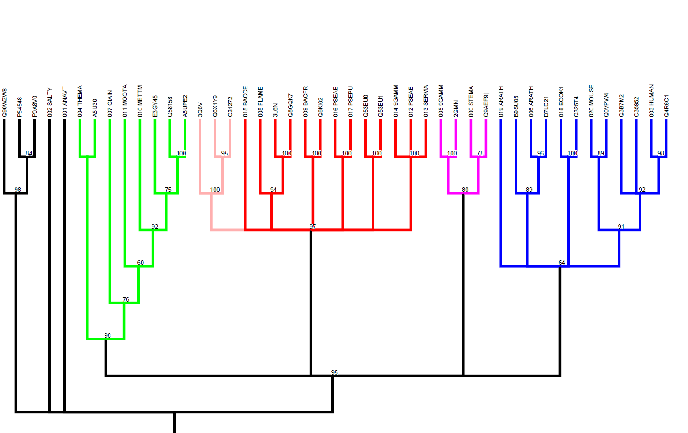
Previous Work
Building trees
Unresolved consensus tree…
MRCA approach
We reconstruct the phylogeny 100 times using randomised bootstrap replicates
B2 lactamases
B3 lactamases
Glyoxalases
Ribonucleases
Flavoproteins
B1 lactamases
?
Notes:
Group of proteins with a common function

Slide 25
Previous Work
Building trees
Unresolved consensus tree…
MRCA approach
If we got an unambiguous tree topology, we could study a single MRCA …
B2 lactamases
B3 lactamases
Glyoxalases
Ribonucleases
Flavoproteins
B1 lactamases
?
Notes:
Group of proteins with a common function

Slide 26
Previous Work
Building trees
Unresolved consensus tree…
MRCA approach
… but the order of branching is not clearly resolved
B2 lactamases
B3 lactamases
Glyoxalases
Ribonucleases
Flavoproteins
B1 lactamases
?
Notes:
Group of proteins with a common function

Slide 27
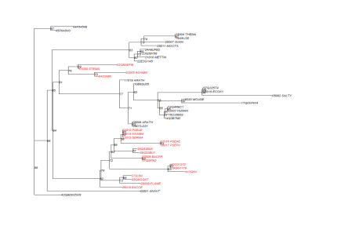
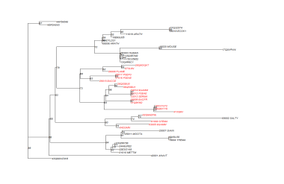
Previous Work
Building trees
Unresolved consensus tree…
MRCA approach
So we went back to our 100 bootstrap reconstructed trees …
>1
----------------------iplp------plsdg--vy-yvwld---------------eftgfgag------------------pltgllv---ypdgri------li----d-----pvcgeggthgllnwg-apg-----klgr-------klkyilithghgdhigglwgllkir--ga-------tvygp------------ggtrallprg--g--------------------------eytlflkggwpdcyy---pga--------------------------------hycd---------rwivwlpeg-rvllg-----------------g---ccfgyrf---avp--gkl-----------------------------------------------------gd--ltlacd-------ftavlvhe-----------y---------------wpktiddyr--sk----fdqvaelg---gvkklipghgd-----------------------------------ggq-----g--lllkayr---dff------------------------------------------------------
>2
---------------------------------lldg--vy----------------------flgfslg-------------------ry-lwi--yyprgcv------lf----d-----pgcgegtphllkhigfapg-----vigr-------glkyillthghgdhvgglkelleif--ga-------tvygp------------agtaallarg--glmfpy-gl------------------eytlllgrgwpdfyy---plp---------------------------------gcd---------rlihpgpgdtrvflg-----------------d---clfgyhl---dpg--gtl-----------------------------------------------------gd--iclacdp--egirgpdvlcgd----------rc-------f-------wpktle--k--ds----fdkikelpkcdglkcllgghgg----------------------------------ygrq-----glkllirkyr---elf------------------------------------------------------
>3
---------------------------------------iy-yglld---------------gfagfgav-------------------lt-lwv---tpdgli------lf----d-----ggcgdgtphllldwg-vpg-----pigk-------klkyilithghgdhigglgllgcrr--ga-------yvygp------------gggrlllpkg--g--------------------------ddtlllgggwpdfyy---pga--------------------------------hwpd---------rvirwlpeg-rvllg-----------------g---cvftarl---tlg--gtl-----------------------------------------------------gc--ltwpckgldglkpgcdvlvge-----------y-------y-------ypgliddyr--hr----fpqaralp---gclillpghgg-----------------------------------ggq-----g--lllkeyl---ely------------------------------------------------------
ASR
Notes:
Highlight here how we could just code function and logically estimate ancestor- but not very informative.
Instead used ASR to get an estimation at a higher granularity.
Using one tree isn’t feasible.

Slide 28
Previous Work
Building trees
Unresolved consensus tree…
MRCA approach
… and obtained the sequence of the putative MRCA of B1, B2 & B3 in each tree.
>1
----------------------iplp------plsdg--vy-yvwld---------------eftgfgag------------------pltgllv---ypdgri------li----d-----pvcgeggthgllnwg-apg-----klgr-------klkyilithghgdhigglwgllkir--ga-------tvygp------------ggtrallprg--g--------------------------eytlflkggwpdcyy---pga--------------------------------hycd---------rwivwlpeg-rvllg-----------------g---ccfgyrf---avp--gkl-----------------------------------------------------gd--ltlacd-------ftavlvhe-----------y---------------wpktiddyr--sk----fdqvaelg---gvkklipghgd-----------------------------------ggq-----g--lllkayr---dff------------------------------------------------------
>2
---------------------------------lldg--vy----------------------flgfslg-------------------ry-lwi--yyprgcv------lf----d-----pgcgegtphllkhigfapg-----vigr-------glkyillthghgdhvgglkelleif--ga-------tvygp------------agtaallarg--glmfpy-gl------------------eytlllgrgwpdfyy---plp---------------------------------gcd---------rlihpgpgdtrvflg-----------------d---clfgyhl---dpg--gtl-----------------------------------------------------gd--iclacdp--egirgpdvlcgd----------rc-------f-------wpktle--k--ds----fdkikelpkcdglkcllgghgg----------------------------------ygrq-----glkllirkyr---elf------------------------------------------------------
>3
---------------------------------------iy-yglld---------------gfagfgav-------------------lt-lwv---tpdgli------lf----d-----ggcgdgtphllldwg-vpg-----pigk-------klkyilithghgdhigglgllgcrr--ga-------yvygp------------gggrlllpkg--g--------------------------ddtlllgggwpdfyy---pga--------------------------------hwpd---------rvirwlpeg-rvllg-----------------g---cvftarl---tlg--gtl-----------------------------------------------------gc--ltwpckgldglkpgcdvlvge-----------y-------y-------ypgliddyr--hr----fpqaralp---gclillpghgg-----------------------------------ggq-----g--lllkeyl---ely------------------------------------------------------
ASR
Notes:
Highlight here how we could just code function and logically estimate ancestor- but not very informative.
Instead used ASR to get an estimation at a higher granularity.
Using one tree isn’t feasible.

Slide 29
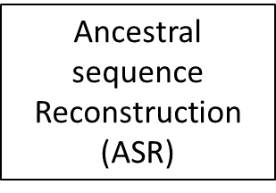
Previous Work
Building trees
Unresolved consensus tree…
MRCA approach
{S ,F}
S
{S, F}
{H, S}
S
H
S
S
S
F
F
We had reconstructed the sequence probabilistically for each node of the tree for each of our 100 runs. We got 98 putative MRCA sequences (two trees were infeasible).
Notes:
This is a parsimonious approach- ML makes different evolutionary assumptions not necessarily the route with the fewest changes. Can differentiate between unions based on quantitative probabilities.
Alignment bigger

Slide 30
Previous Work
Unresolved consensus tree…
MRCA approach
Building trees
MRCA approach
98 MRCAs
44 match IPR001018
54 do not match
44 of the 98 MRCA sequence predictions hit InterPro signature IPR001018, “Beta-lactamase, class-B, conserved site”, which indicates the presence of some key zinc binding and catalytic residues.

Slide 31
Previous Work
Building trees
Unresolved consensus tree…
MRCA approach
98 MRCAs
44 match IPR001018
54 do not match
However, this match is necessary but not sufficient to indicate that the protein actually has the catalytic capability of hydrolysing β-lactams. So we need to find another way of looking for catalytic capability. Thus, we build 3D homology model structures of these putative ancestral proteins.

Slide 32
Previous Work
Building trees
Unresolved consensus tree…
MRCA approach
44 match IPR001018
β-lactamase signature
1
2
3
2
7
2
2
5
4
8
8
Cluster at sequence ID of 60% 11 clusters. Take 1 representative from each cluster and build an homology model of it (Phyre2).

Slide 33
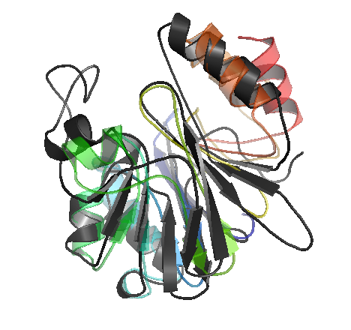
Previous Work
Building trees
Unresolved consensus tree…
MRCA approach
11 cluster representative sequences
11 Homology models (Phyre2).
Notes:
In each case explain why this means its unlikely to be a beta lactamase.
Likely 3d structure vs fold
Organismal fitness than survival.
Did original alignment include flavodoxin domain?

Slide 34
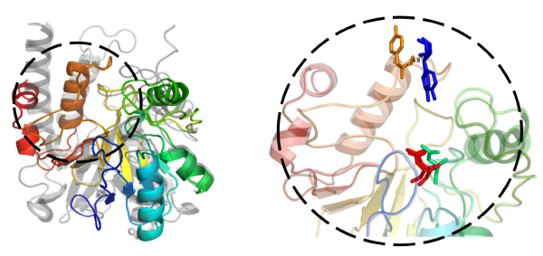
Previous Work
Building trees
Unresolved consensus tree…
MRCA approach
Remember that matching sequence signature IPR001018 is necessary but not sufficient to indicate that the protein can hydrolyse β-lactams.
We design a 3D template model, a match to which would provide stronger evidence of β-lactamase activity. We built separate templates for B1, B2 and B3.
So we look for matches to those templates in the 11 homology models …
Notes:
In each case explain why this means its unlikely to be a beta lactamase.
Likely 3d structure vs fold
Organismal fitness than survival.
Did original alignment include flavodoxin domain?

Slide 35
Previous Work
Building trees
Unresolved consensus tree…
MRCA approach
… and we find that one MRCA homology model hits our B3 template, but that there are no other matches.
Notes:
In each case explain why this means its unlikely to be a beta lactamase.
Likely 3d structure vs fold
Organismal fitness than survival.
Did original alignment include flavodoxin domain?

Slide 36
Previous Work
Building trees
Unresolved consensus tree…
MRCA approach
44 match IPR001018
β-lactamase signature
1
2
3
2
7
2
2
5
4
8
8
The homology modelled MRCA that hits our B3 template is from a five-member cluster and hence represents 5 of the 98 independent MRCAs.

Slide 37
Interpretation 1 (Occam’s Razor)
We have found a feasible evolutionary trajectory in structure and sequence space that allows both B1/B2 and B3 metallo-β-lactamases to evolve from a common ancestor with β-lactamase activity.
Since originating the same catalytic functionality twice in the same superfamily seems complex and difficult, we should prefer the simpler, more parsimonious, explanation.
This interpretation implies a single evolutionary origin of β-lactamase activity in this superfamily.

Slide 38
Interpretation 2 (statistical)
Only 5 out of 98 of our simulated reconstructed MRCAs corresponds to a protein with (presumptive) metallo-β-lactamase activity. So in 95% of cases we recreate an MRCA that is not a β-lactamase.
This interpretation implies two separate evolutionary origins in the same superfamily.

Slide 39
In Support of Interpretation 1
We would need to convince ourselves that we are happy despite finding the catalytically competent ancestor in only 5 of 98 trials. Excuses might be …
Our models don’t reproduce the selective pressure that real evolution operates under and hence driving force for the in silico ancestral sequences for be functional fitness-enhancing proteins is lacking;
Ancient enzymes may have had a useful level of β-lactamase activity without hitting the ‘modern’ 3D template. So we might have missed the functional active site of an ancestor because it doesn’t look like what we were expecting a lactamase to look like.

Slide 40
In Support of Interpretation 2
Beyond the 93:5 statistical argument …
There are indeed several reported cases of the same functional evolving twice in a given superfamily.
Previous work by Hall et al. supported two separate origins, B1 & B2 gaining β-lactamase function 1 billion years ago, and B3 acquiring it 2 billion years ago.

Slide 41
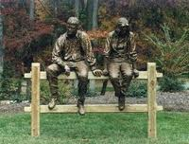

Slide 42
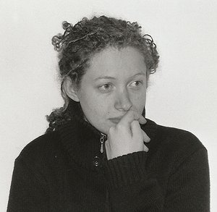
Thanks
Dr Rosie Alderson
Dr Daniel Barker
Dr Luna De Ferrari

